Slide 1

Statistical Methods:
Cross Section Measurement
Christian Veelken
christian.veelken@cern.ch

Slide 2

Outline
Measurement of a cross section
Systematic uncertainties
Experimental uncertainties
Theory uncertainties
Maximum likelihood method with systematic uncertainties
Nuisance parameters
Extended likelihood function
Probability density functions for extended likelihood function
Log-normal distribution
Gamma distribution
☞ Exercise
Christian Veelken Statistical Methods: Cross Section Measurement 2

Slide 3
Measurement of a Cross Section
The expected number of produced Z boson events is given by
(cf. slide 6 of part 1)
Luminosity
(amount of proton-proton collisions recorded by CMS detector)
Cross section
Christian Veelken Statistical Methods: Cross Section Measurement 3

Slide 4
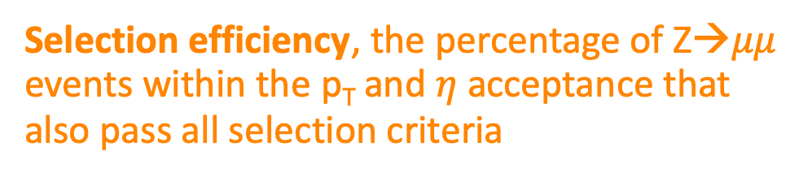

Measurement of a Cross Section
The expected number of selected Z→$μμ$ events is given by
Acceptance, the percentage of Z→$μμ$ events that pass the selection on muon p_{T} and $η$
Selection efficiency, the percentage of Z→$μμ$ events within the p_{T} and $η$ acceptance that also pass all selection criteria
Branching fraction, the probability for Z bosons to decay to a pair of muons (= 3.37%)
http://pdg.lbl.gov/2018/listings/rpp2018-list-z-boson.pdf
Christian Veelken Statistical Methods: Cross Section Measurement 4

Slide 5
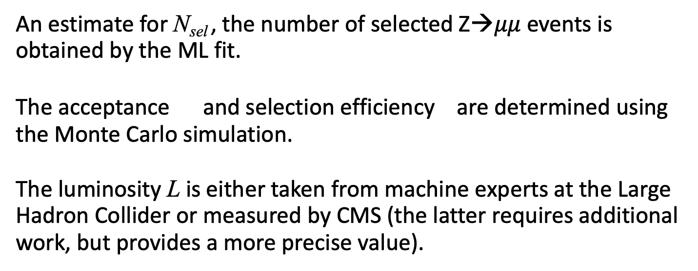
Measurement of a Cross Section
The cross section is thus given by
An estimate for N_{sel} , the number of selected Z→$μμ$ events is obtained by the ML fit.
The acceptance and selection efficiency are determined using the Monte Carlo simulation.
The luminosity L is either taken from machine experts at the Large Hadron Collider or measured by CMS (the latter requires additional work, but provides a more precise value).
Christian Veelken Statistical Methods: Cross Section Measurement 5

Slide 6
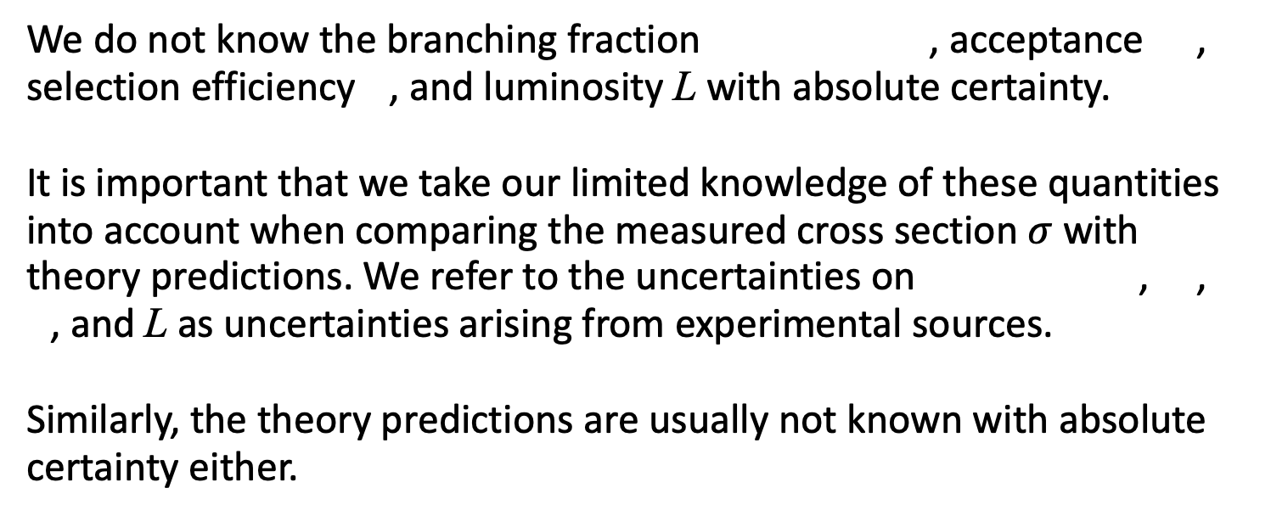
Systematic Uncertainties
We do not know the branching fraction , acceptance , selection efficiency , and luminosity L with absolute certainty.
It is important that we take our limited knowledge of these quantities into account when comparing the measured cross section $σ$ with theory predictions. We refer to the uncertainties on , ,
, and L as uncertainties arising from experimental sources.
Similarly, the theory predictions are usually not known with absolute certainty either.
Christian Veelken Statistical Methods: Cross Section Measurement 6

Slide 7
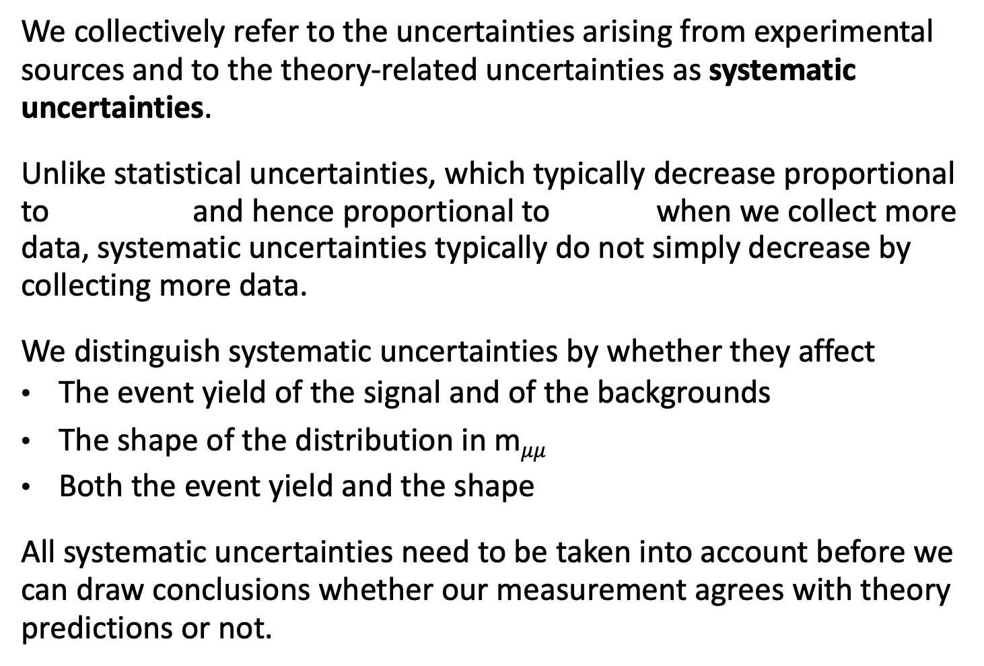
Systematic Uncertainties
We collectively refer to the uncertainties arising from experimental sources and to the theory-related uncertainties as systematic uncertainties.
Unlike statistical uncertainties, which typically decrease proportional to and hence proportional to when we collect more data, systematic uncertainties typically do not simply decrease by collecting more data.
We distinguish systematic uncertainties by whether they affect
The event yield of the signal and of the backgrounds
The shape of the distribution in m$μμ$
Both the event yield and the shape
All systematic uncertainties need to be taken into account before we can draw conclusions whether our measurement agrees with theory predictions or not.
Christian Veelken Statistical Methods: Cross Section Measurement 7

Slide 8
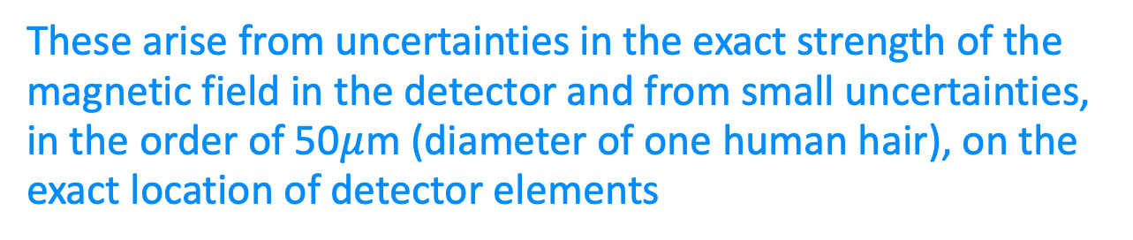
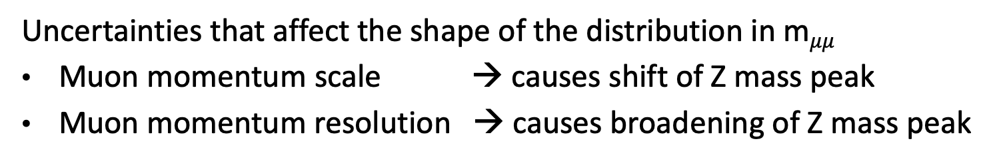
Experimental Uncertainties
Uncertainties that affect event yields
Trigger efficiency
Efficiency of muon reconstruction, identification, and isolation selection
Luminosity
Uncertainties that affect the shape of the distribution in m$μμ$
Muon momentum scale → causes shift of Z mass peak
Muon momentum resolution → causes broadening of Z mass peak
These arise from uncertainties in the exact strength of the magnetic field in the detector and from small uncertainties, in the order of 50$μ$m (diameter of one human hair), on the exact location of detector elements
Christian Veelken Statistical Methods: Cross Section Measurement 8

Slide 9
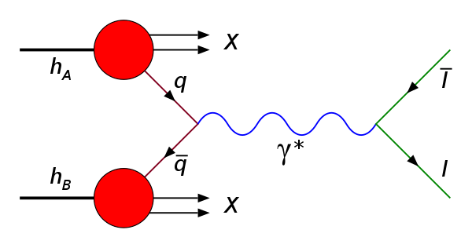
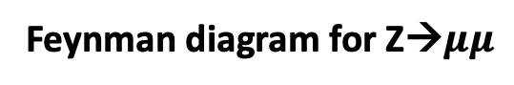
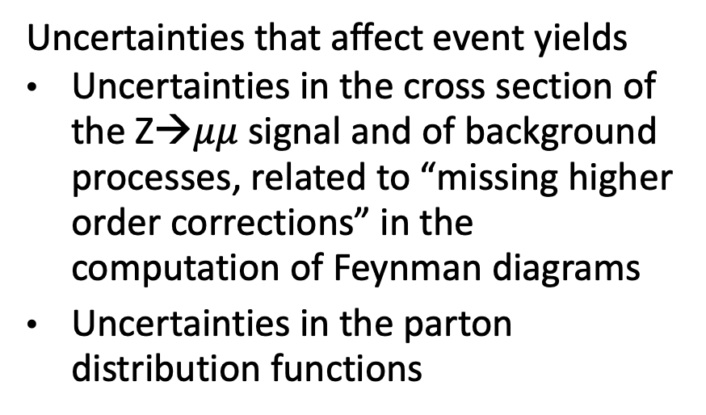
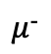
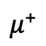
Theory Uncertainties
Uncertainties that affect event yields
Uncertainties in the cross section of the Z→$μμ$ signal and of background processes, related to “missing higher order corrections” in the computation of Feynman diagrams
Uncertainties in the parton distribution functions
Feynman diagram for Z→$μμ$
p
$μ$⁺
$μ$⁻
p
Parton distribution functions
The gluon PDF is divided by 10 to make it fit within the y-axis range
Fraction of proton momentum carried by quark or gluon
Christian Veelken Statistical Methods: Cross Section Measurement 9

Slide 10
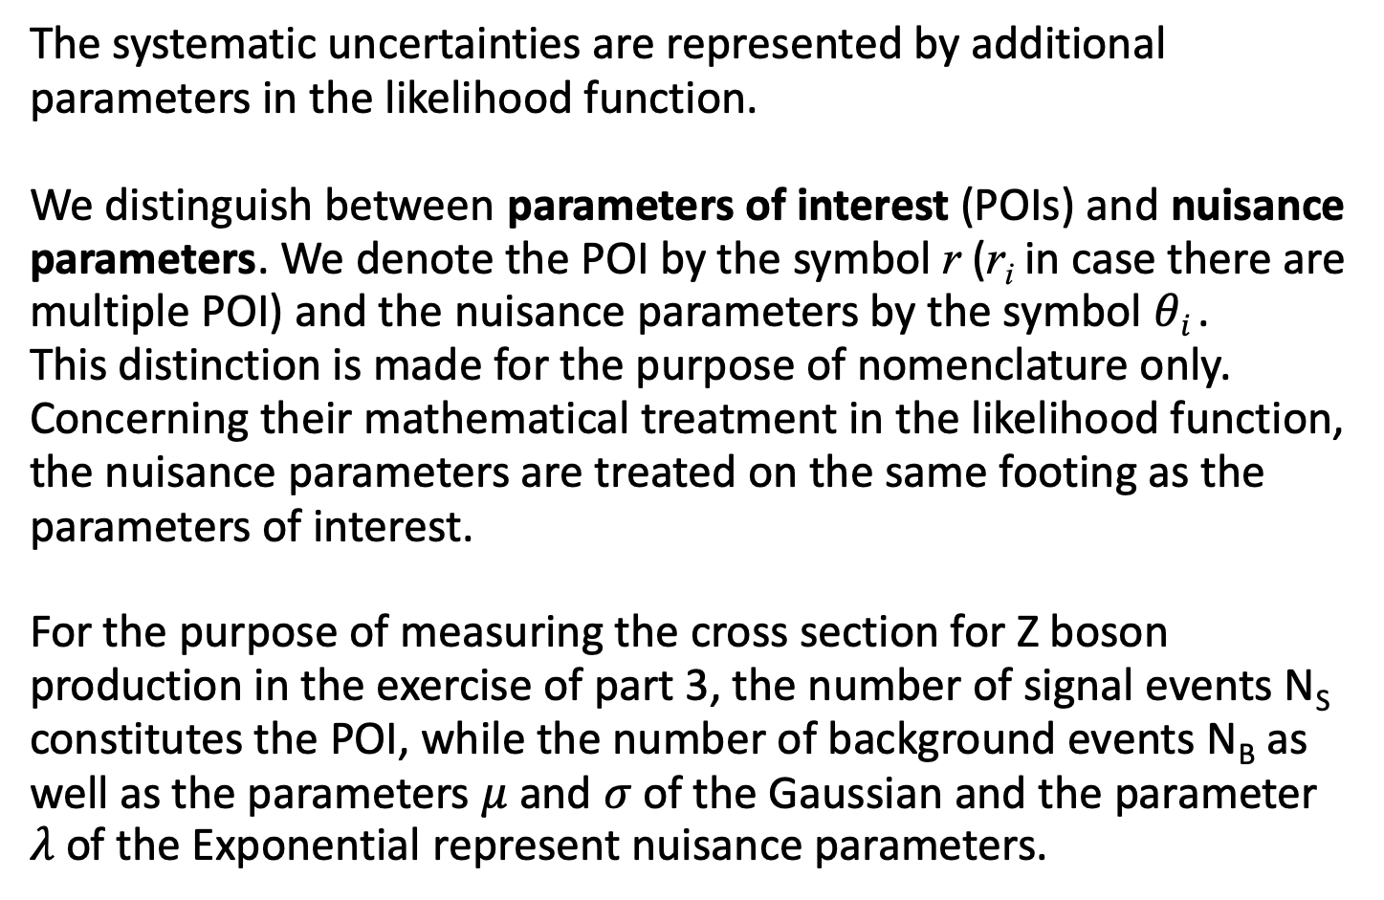
Nuisance Parameters
The systematic uncertainties are represented by additional parameters in the likelihood function.
We distinguish between parameters of interest (POIs) and nuisance parameters. We denote the POI by the symbol r (r_{i} in case there are multiple POI) and the nuisance parameters by the symbol $θi$ .
This distinction is made for the purpose of nomenclature only.
Concerning their mathematical treatment in the likelihood function, the nuisance parameters are treated on the same footing as the parameters of interest.
For the purpose of measuring the cross section for Z boson production in the exercise of part 3, the number of signal events N_{S} constitutes the POI, while the number of background events N_{B} as well as the parameters $μ$ and $σ$ of the Gaussian and the parameter $λ$ of the Exponential represent nuisance parameters.
Christian Veelken Statistical Methods: Cross Section Measurement 10

Slide 11
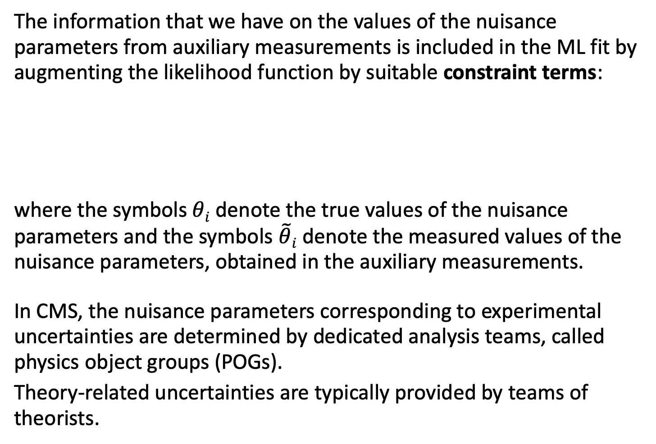
Extended Likelihood Function
The information that we have on the values of the nuisance parameters from auxiliary measurements is included in the ML fit by augmenting the likelihood function by suitable constraint terms:
where the symbols $θi$ denote the true values of the nuisance parameters and the symbols $\tilde{θ}i$ denote the measured values of the nuisance parameters, obtained in the auxiliary measurements.
In CMS, the nuisance parameters corresponding to experimental uncertainties are determined by dedicated analysis teams, called physics object groups (POGs).
Theory-related uncertainties are typically provided by teams of theorists.
Christian Veelken Statistical Methods: Cross Section Measurement 11

Slide 12
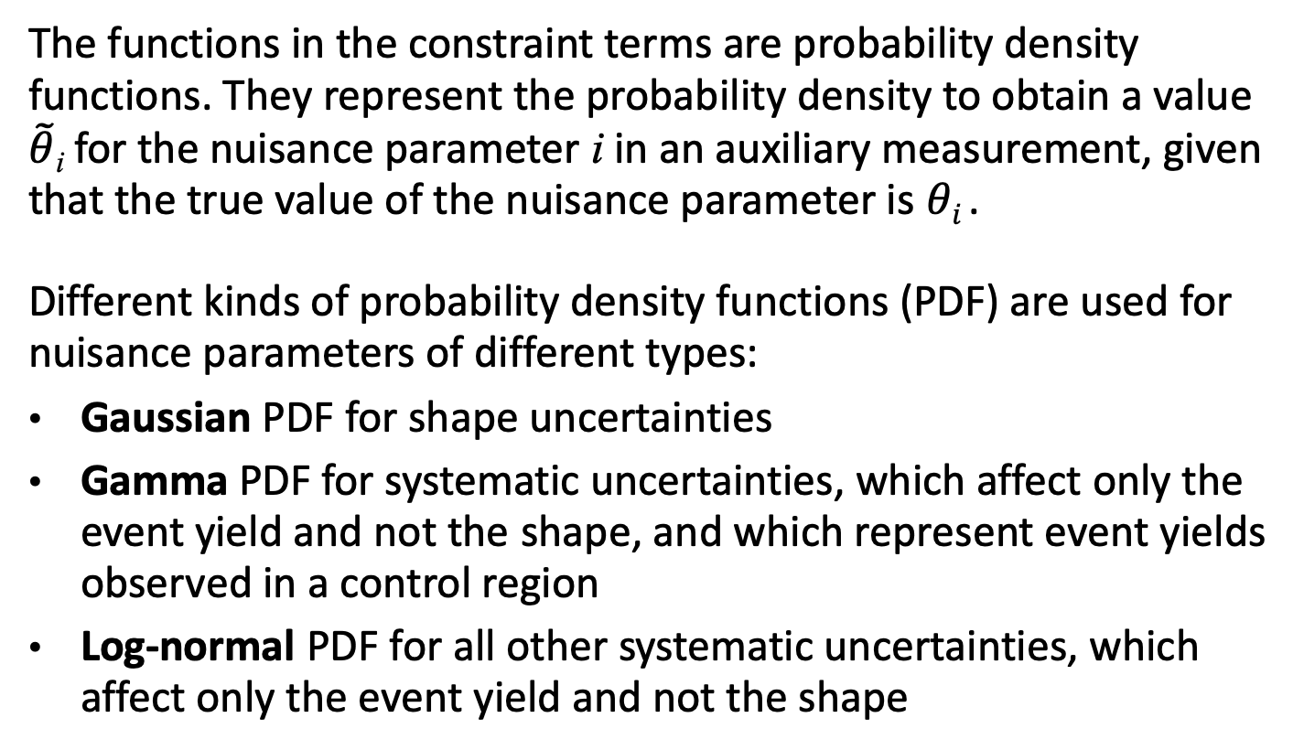
PDFs for Extended Likelihood Function
The functions in the constraint terms are probability density functions. They represent the probability density to obtain a value $\tilde{θ}$_{i} for the nuisance parameter i in an auxiliary measurement, given that the true value of the nuisance parameter is $θi$ .
Different kinds of probability density functions (PDF) are used for nuisance parameters of different types:
Gaussian PDF for shape uncertainties
Gamma PDF for systematic uncertainties, which affect only the event yield and not the shape, and which represent event yields observed in a control region
Log-normal PDF for all other systematic uncertainties, which affect only the event yield and not the shape
Christian Veelken Statistical Methods: Cross Section Measurement 12

Slide 13
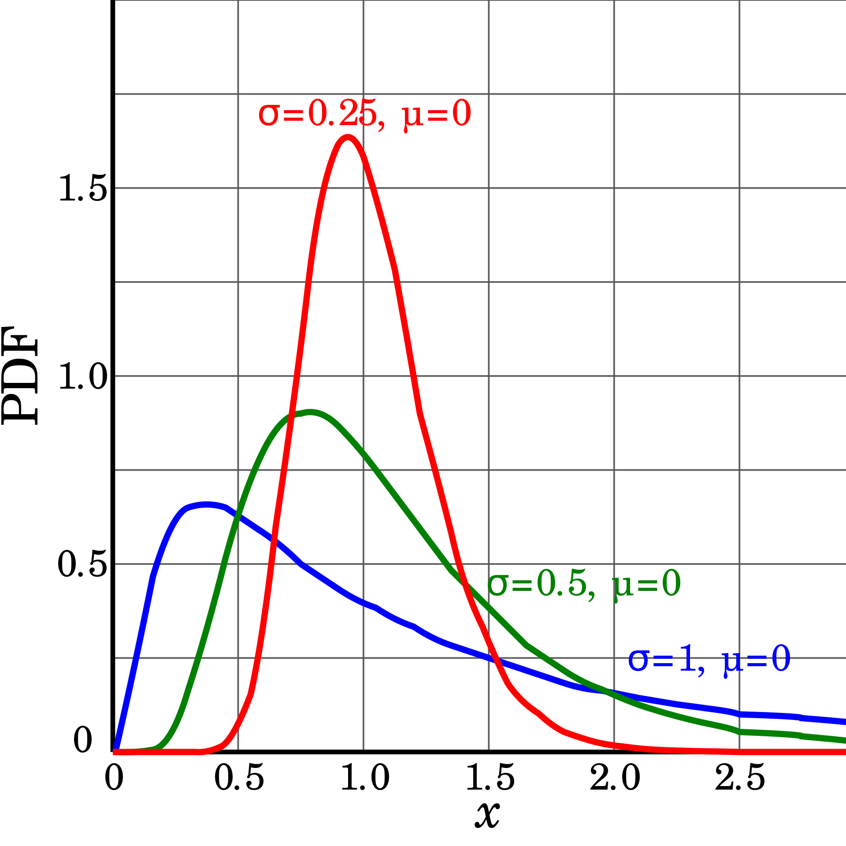
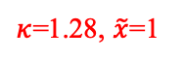
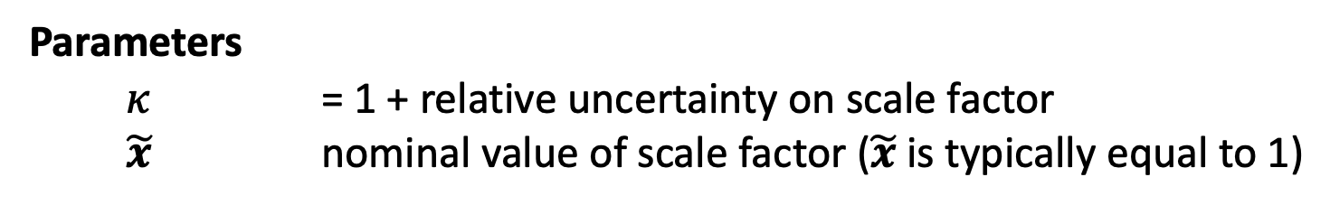
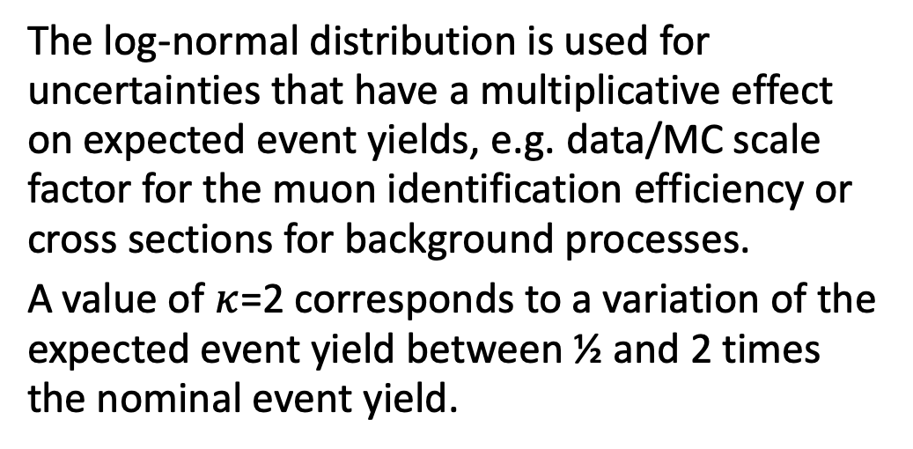
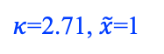
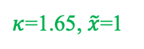
Log-Normal Distribution
Probability density function
Log-Normal PDF
$κ$=1.28, $\tilde{x}$=1
The log-normal distribution is used for uncertainties that have a multiplicative effect on expected event yields, e.g. data/MC scale factor for the muon identification efficiency or cross sections for background processes.
A value of $κ$=2 corresponds to a variation of the expected event yield between ½ and 2 times the nominal event yield.
$κ$=1.65, $\tilde{x}$=1
$κ$=2.71, $\tilde{x}$=1
Parameters
$κ$ = 1 + relative uncertainty on scale factor
$\tilde{x}$ nominal value of scale factor ($\tilde{x}$ is typically equal to 1)
https://en.wikipedia.org/wiki/Log-normal_distribution
Christian Veelken Statistical Methods: Cross Section Measurement 13

Slide 14
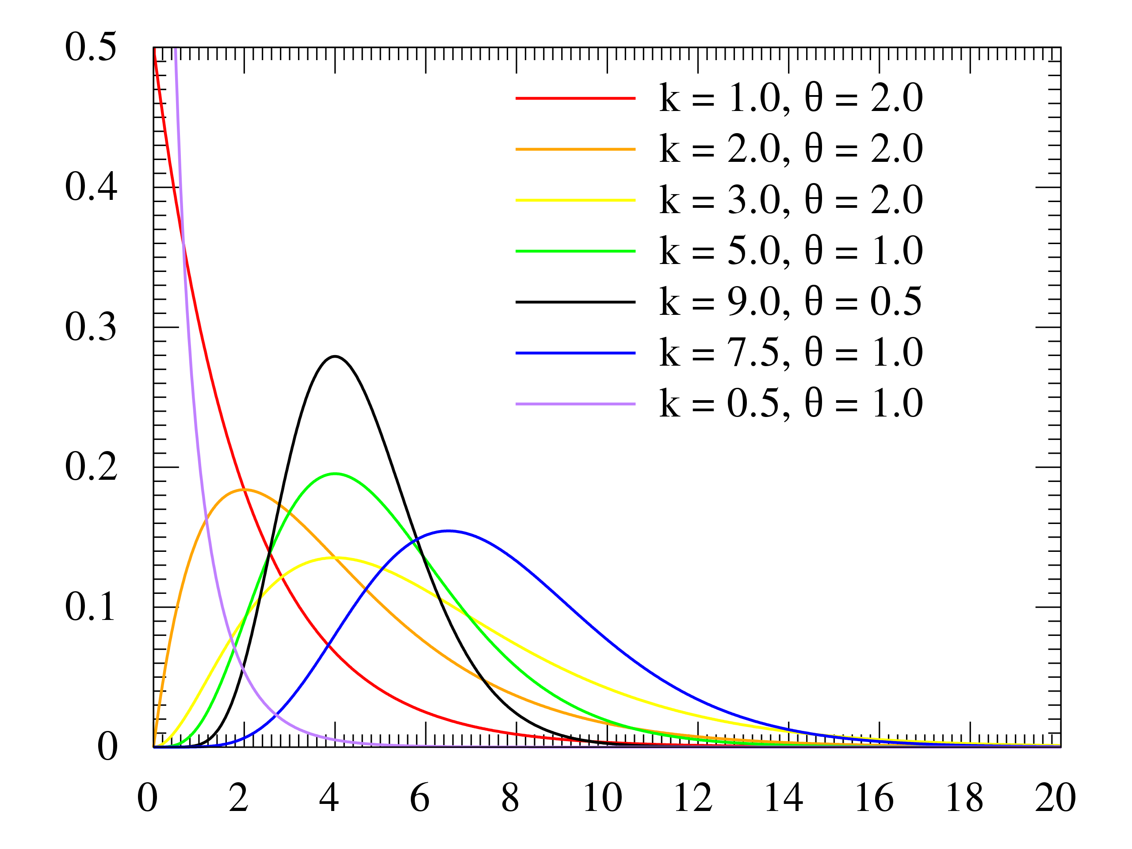
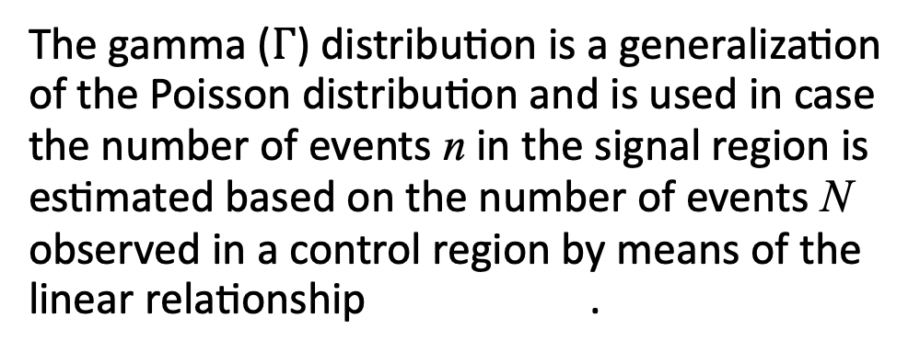
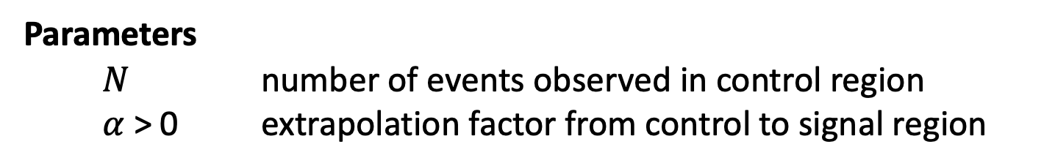
Gamma Distribution
Probability density function
Gamma PDF
The gamma ($Γ$) distribution is a generalization of the Poisson distribution and is used in case the number of events n in the signal region is estimated based on the number of events N observed in a control region by means of the linear relationship .
= N+1
n
The parameter $α$ is called the extrapolation factor.
Parameters
$N$ number of events observed in control region
$α$ > 0 extrapolation factor from control to signal region
https://en.wikipedia.org/wiki/Gamma_distribution
Christian Veelken Statistical Methods: Cross Section Measurement 14

Slide 15
Exercise
The purpose of this exercise is to extend the exercise of part 3
by a systematic uncertainty on the muon identification efficiency
and study the effect of this systematic uncertainty on the ML fit.
Implement bonus part 1 of the exercise in part 3, if you have not already done so.
When you generate the pseudo data, determine a data/MC scale factor (SF) for the muon identification efficiency by randomly sampling from a Gaussian with a width of 5%.
For the purpose of this exercise, we will assume that all reconstructed muons in background events are genuine muons, so that the event yields of the Z→ signal as well as the event yields of all backgrounds scale as SF² .
Christian Veelken Statistical Methods: Cross Section Measurement 15

Slide 16
Exercise
Typical muon identification efficiency in CMS [*]
double eff_muon = 0.80;
double effErr_muon = 0.05*eff_muon;
double eff_muon_rnd = rnd.Gaus(eff_muon, effErr_muon);
if ( eff_muon_rnd < 0.01 ) eff_muon_rnd = 0.01;
if ( eff_muon_rnd > 1.00 ) eff_muon_rnd = 1.00;
// Signal yield is affected by muon identification efficiency^2,
// as each signal event contains two muons
double numEvents_signal_rnd =
TMath::Power( eff_muon_rnd/eff_muon , 2.)*numEvents_signal;
// Assume all muons in background events are genuine muons,
// so the background yield is affected by muon identification efficiency^2
// in the same way as the signal
double numEvents_background_rnd =
TMath::Power(eff_muon_rnd/eff_muon, 2.)*numEvents_background;
5% uncertainty on data/MC SF means 5% relative uncertainty on muon identification efficiency
This ratio represents the data/MC SF for the muon identification efficiency
[*] Exact value does not matter for this exercise, but assuming a muon identification efficiency of 100% will not work, as upward fluctuations are truncated in this case, as efficiencies are at most 100%
Christian Veelken Statistical Methods: Cross Section Measurement 16

Slide 17
Exercise
RooRealVar norm_S("norm_S", "Signal yield", numEvents_S, 0., maxEvents);
RooRealVar norm_B("norm_B", "Background yield", numEvents_B, 0., maxEvents);
// Create constraint term in likelihood function
// for systematic uncertainty on muon identification efficiency
RooRealVar sf_muon("sf_muon", "Data/MC scale-factor for muon eff", 1., 0., 1./eff_muon);
RooConstVar const0("const0", "Constant of value 1", 1.);
RooConstVar const1("const1", "Uncertainty on muon eff", effErr_muon/eff_muon );
RooGaussian constraint_muon("constraint_muon", "Constraint term", sf_muon, const0, const1);
RooFormulaVar norm_S_wMuonEff("norm_S_wMuonEff", "Signal yield*muon eff^2",
"norm_S*sf_muon*sf_muon", RooArgList(norm_S, sf_muon));
RooFormulaVar norm_B_wMuonEff("norm_B_wMuonEff", "Background yield*muon eff^2",
"norm_B*sf_muon*sf_muon", RooArgList(norm_B, sf_muon));
RooAddPdf model_SplusB("model_SplusB", "S+B model",
RooArgList(model_S, model_B), RooArgList(norm_S_wMuonEff, norm_B_wMuonEff));
RooProdPdf model_SplusB_wMuonEff("model_SplusB_wMuonEff", "S+B model with muon eff",
model_SplusB, constraint_muon);
= 5%
We use a variable of type RooFormulaVar to let RooFit know that the number of signal and background events in the pseudo data changes proportional to the square of the data/MC SF for the muon identification efficiency
The variable of type RooProdPDF represent the likelihood function with constraint term
/home/veelken/public/PhyStat-101/exercise_part04.C
Christian Veelken Statistical Methods: Cross Section Measurement 17

Slide 18
Exercise
N.B.: According to slides 12 and 13, it would be more appropriate to randomly sample from a log-normal distribution and use a log-normal PDF for the constraint term in the likelihood function.
Provided that the uncertainty on the data/MC SF for the muon identification efficiency is small (a few %), using a Gaussian is a good approximation for a log-normal PDF.
The motivation for using a Gaussian in the exercise is simply that we have already implemented the random sampling for a Gaussian.
Christian Veelken Statistical Methods: Cross Section Measurement 18

Slide 19
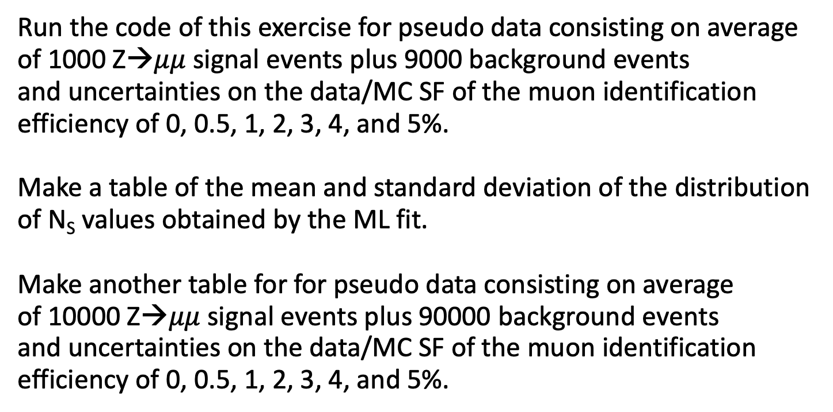
Exercise
Run the code of this exercise for pseudo data consisting on average of 1000 Z→$μμ$ signal events plus 9000 background events
and uncertainties on the data/MC SF of the muon identification efficiency of 0, 0.5, 1, 2, 3, 4, and 5%.
Make a table of the mean and standard deviation of the distribution of N_{S} values obtained by the ML fit.
Make another table for for pseudo data consisting on average
of 10000 Z→$μμ$ signal events plus 90000 background events
and uncertainties on the data/MC SF of the muon identification efficiency of 0, 0.5, 1, 2, 3, 4, and 5%.
Christian Veelken Statistical Methods: Cross Section Measurement 19

Slide 20
Backup

Slide 21
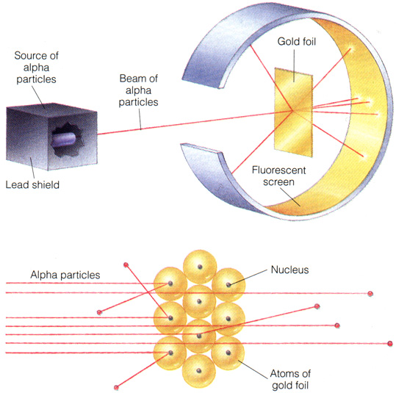
Rutherford Experiment
Scattering as a tool to explore the structure of matter
Pioneered in 1909 by Hans Geiger and Ernest Marsden, in collaboration with Ernest Rutherford, when they fired a beam of α particles (helium nuclei) on a thin gold foil.
Some of the α particles were deflected by large angles, while the majority of α particles passed through the foil with little deflection.
From this observation, Rutherford concluded that the mass of gold atoms is concentrated in a very small core of positive charge, the nucleus.
Christian Veelken Statistical Methods: Cross Section Measurement 21

Slide 22
Elastic Collisions
The α particles and gold atoms remain intact in the Rutherford experiment.
These collisions are called elastic collisions
Elastic collisions occur mainly when the kinetic energies of the colliding particles is small
Momentum is conserved:
Kinetic energy is conserved:
Christian Veelken Statistical Methods: Cross Section Measurement 22

Slide 23
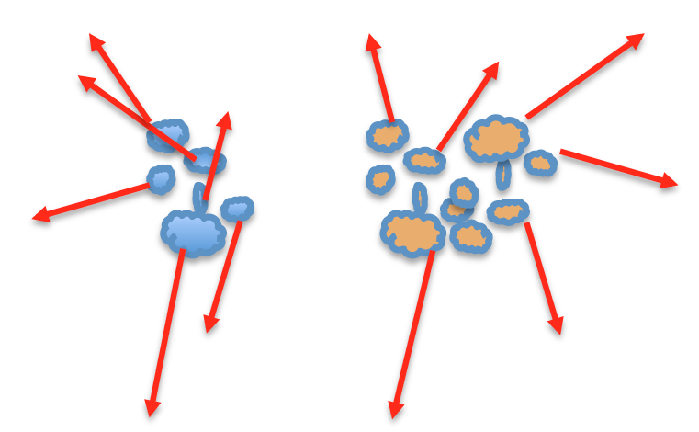
Inelastic Collisions
When the kinetic energy of the colliding particle increases,
inelastic collisions become more probable than elastic collisions
In inelastic collisions, one or both of the colliding particles breaks-up
Momentum is conserved, but kinetic energy is not conserved in inelastic collisions (only total energy is)
Christian Veelken Statistical Methods: Cross Section Measurement 23

Slide 24
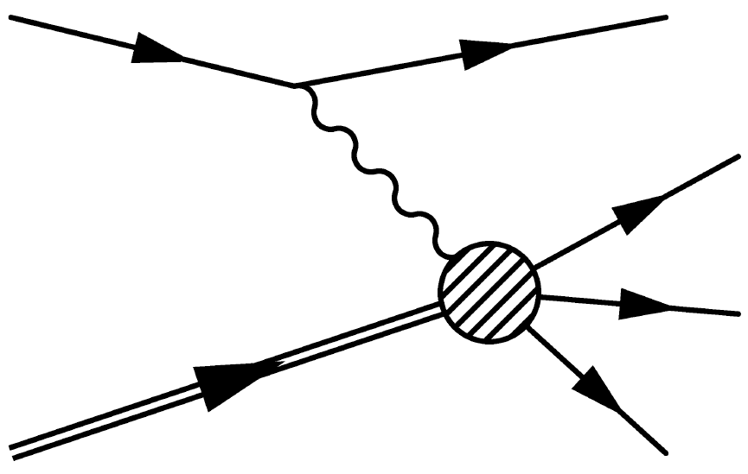
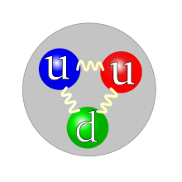
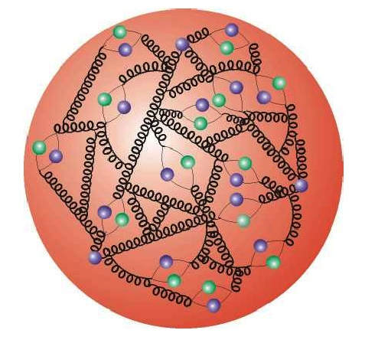
Deep Inelastic Scattering
e
e
Deep inelastic electron-proton scattering allows to explore the structure of the proton
γ(Q²)
Collision characterized by momentum transfer Q² from the electron
p
Stuff
We find that besides the valence quarks (uud)
the proton contains a multitude of virtual quarks and gluons, which arise from quantum fluctuations and are short lived
(limited by the uncertainty principle)
Christian Veelken Statistical Methods: Cross Section Measurement 24

Slide 25
Parton Distribution Functions
The valence quarks as well as the virtual quarks and gluons are collectively called partons
The most common parton inside the proton is the gluon (carrier of the strong force)
The gluon PDF is divided by 10 to make it fit within the y-axis range
The partons carry fractions x of the proton momentum
The probability to find a parton with momentum fraction x is given by the parton distribution functions (PDFs)
Christian Veelken Statistical Methods: Cross Section Measurement 25

